Slide 1
Enterprise-ready cloud
Notes:
Information in this document, including URL and other Internet Web site references, is subject to change without notice. Unless otherwise noted, the example companies, organizations, products, domain names, e-mail addresses, logos, people, places, and events depicted herein are fictitious, and no association with any real company, organization, product, domain name, e-mail address, logo, person, place or event is intended or should be inferred. Complying with all applicable copyright laws is the responsibility of the user. Without limiting the rights under copyright, no part of this document may be reproduced, stored in or introduced into a retrieval system, or transmitted in any form or by any means (electronic, mechanical, photocopying, recording, or otherwise), or for any purpose, without the express written permission of Microsoft Corporation.
Microsoft may have patents, patent applications, trademarks, copyrights, or other intellectual property rights covering subject matter in this document. Except as expressly provided in any written license agreement from Microsoft, the furnishing of this document does not give you any license to these patents, trademarks, copyrights, or other intellectual property.
The names of manufacturers, products, or URLs are provided for informational purposes only and Microsoft makes no representations and warranties, either expressed, implied, or statutory, regarding these manufacturers or the use of the products with any Microsoft technologies. The inclusion of a manufacturer or product does not imply endorsement of Microsoft of the manufacturer or product. Links may be provided to third party sites. Such sites are not under the control of Microsoft and Microsoft is not responsible for the contents of any linked site or any link contained in a linked site, or any changes or updates to such sites. Microsoft is not responsible for webcasting or any other form of transmission received from any linked site. Microsoft is providing these links to you only as a convenience, and the inclusion of any link does not imply endorsement of Microsoft of the site or the products contained therein.
© 2017 Microsoft Corporation. All rights reserved.
Microsoft and the trademarks listed at https://www.microsoft.com/en-us/legal/intellectualproperty/Trademarks/Usage/General.aspx are trademarks of the Microsoft group of companies. All other trademarks are property of their respective owners.
March 2020

Slide 2
Abstract and learning objectives
In this whiteboard design session, you will work in a group to design a comprehensive solution to address concerns about cost management, security, subscription and resource management, identity, deployment, and other areas to help apply an enterprise governance model for Trey Research.
At the end of this whiteboard design session, you will be better able to design a governance plan to showcase the security, governance, and cost management features of Azure. In addition, you'll learn how to provide cost tracking and alerting by business unit and environment, implement a distributed administration model, and control the deployment of Azure services, all delivered at scale across a large enterprise.

Slide 3
Step 1: Review the customer case study
Outcome
Analyze your customer needs.
Timeframe
15 minutes

Slide 4
Customer situation
Trey Research
Consumer products manufacturing company
Annual revenues of USD $29.6 billion
Global company
Headquarters in New Jersey
Major offices in the UK, France, and Japan
Data centers and branch offices scattered across the United States
Looking to mitigate creeping costs as well as start the transition to a modern cloud enterprise architecture
Large EA commitment to Azure
Notes:
Trey Research is a manufacturing company that builds consumer products with 29.6 billion USD in annual revenue. Trey's headquarters are in New Jersey, but they have data centers and branch offices scattered across the United States with several major offices in the United Kingdom, France, and Japan.
Even as large as it is, Trey seeks to maximize the cost-effectiveness and flexibility of its IT, especially in new projects and business units. With a dizzying number of existing business units, each with its own unique requirements from IT and ballooning costs from internal hardware and data center investment, Trey is looking to the cloud.
Trey is interested in a large-scale solution that will help mitigate creeping costs and start the transition to a modern cloud-based enterprise architecture.
Trey's technical leadership has decided to move forward with a Microsoft enterprise agreement (EA) with a heavy commitment in Microsoft Azure.

Slide 5
Customer situation
Ken Greenwald, Trey Research’s CTO
Understands the value of the cloud
Focus on best practices and controls
Wants to avoid mistakes that lead to trouble later on
Laura Knight, Head of Cloud Governance team
Reports to Ken
Responsible for defining, implementing and enforcing Azure governance
Works with other teams to ensure best practices are adopted
Wants to adopt Microsoft's Cloud Adoption Framework as a baseline for Azure governance
Notes:
Trey Research's CTO, is aware of the potential for the cloud, but also has a keen understanding that without strong governance, Trey may end up with an environment that lacks essential business controls. These incorrect practices can then be disbursed across the enterprise, leading to an unmanageable Azure estate and costs which are hard to track or control. Ken wants to start on the right foot by enforcing common-sense best practices from the start.
Enterprise IT is responsible for managing corporate network connectivity, datacenter distribution, capacity planning, identity, and enterprise wide SaaS services for Trey Research employees. Enterprise IT is also responsible for supporting the services, datacenters, and setting auditing policy on hardware and services.
To help drive Azure adoption and best practices, Ken has chartered a Cloud Governance team within Enterprise IT, headed by Laura Knight. This team will be responsible for all aspects of Azure governance. This includes defining, implementing and enforcing cloud governance and working with other teams to ensure best practices are adopted.
Rather than re-invent the wheel, the Cloud Governance team have decided to adopt Microsoft's Cloud Adoption Framework as a baseline upon which they will build their governance implementation. This framework is divided into five disciplines.

Slide 6
IT organization
Each business unit has its own IT resources and IT budget
Track and alert on costs by business unit, project, and workload type
Delegate management to business unit IT
Trey Research
Industrial & Consumer
Electronics
Life Sciences
Product
Development
Marketing
Sales & Support
Product
Development
Marketing
Sales & Support
Product
Development
Marketing
Sales & Support
Regional (US/EU/Asia)
Regional (US/EU/Asia)
Regional (US/EU/Asia)
Notes:
Trey Research has three business units: Industrial and Consumer, Electronics, and Life Sciences. Each of the Business Units has the same subunits: Product development, Marketing, and Sales and Support. Sales and Support is further divided into region subunits (US/EU/Asia).

Slide 7
Customer Needs—Cost Management
Provide cost management tools for budgets, alerts, dashboards, spending reports, forecasts, anomaly detection and investigation, and cost-saving recommendations
Implement a charge back mechanism for the business units for resources they consume based on the IO code for each application
Enable allocation of costs between categories: Development and Test, Production, Support Services, and Infrastructure
Notes:
Each business unit and subunit is allocated an Azure quota/budget and is responsible for tracking their expenditure within that budget. Within a business unit, each new project should track its consumption using a specific tag for its IO code within the business unit.
In addition, each business unit has a requirement to break down their costs into the following categories. Accurate allocation of costs between this categories is essential, since this data feeds into gross margin and net profit figures collated by the central finance team and published quarterly to investors.
- Development and Test
- Production
- Support Services
- Infrastructure
Business units and the finance department need tools to accurately and reliably track all Azure costs, including a cost management dashboard and reports to understand current costs and projected future costs. Alerts when budgets are approached or exceeded are required.
In addition, the Cloud Governance team's charter includes company-wide monitoring and reporting of all Azure spend, including reviewing usage to identify cost-saving opportunities and identifying and investigating anomalous spending.

Slide 8
Customer Needs—Security Baseline
Enable investigation of changes leading up to any outage
Who, when, what – including before/after state for each Azure resource
Azure resources and in-VM configuration
Ensure Windows and Linux VMs meet password complexity requirements
Ensure VMs can only be created using an approved OS image
Built-in or custom images
Notes:
The IT security team have advised a precautionary approach to cloud adoption. The Cloud Governance team are keen to adopt a strong set of best practices to make sure the IT security and business teams feel comfortable to avoid security becoming an adoption blocker.
If a service has an outage, it is important to know the chain of events that led up to the outage and who (if anyone) caused it.
IT security require that all Azure VMs (Windows and Linux) meet their password complexity requirements. They also require that only approved OS images are used as the baseline for any VM.

Slide 9
Customer Needs—Resource Consistency
Allow the Cloud Governance team to control which Azure services can be used across the business units, while allowing controlled exceptions
Control resource types and expensive configurations within common resource types
Exceptions must be limited to a specific resource type and resource group
Prevent accidental deletion of resources
Implement a common resource naming standard across the organization
Notes:
While the Cloud Governance team is not yet familiar with the full range of Azure services available. They want to limit Trey's Azure adoption to an initial set of core services and locations, which will be expanded over time. These should be centrally enforced, with the ability to grant exceptions where required (for example, for teams piloting new technologies, or one-off deployments of a shared resource such as an ExpressRoute circuit).
The IT Security team is particularly concerned about production environments. These require additional controls to ensure that resources cannot be accidentally modified or deleted by administrators getting confused between a test workload versus production.
To maintain consistency, the Cloud Governance team is developing a set of naming conventions. These names will apply to subscriptions, resource groups and resources. Trey require the ability to enforce this naming convention consistently across their Azure subscriptions.

Slide 10
Customer Needs—Identity Baseline
Delegate access management to business units for each application they own
Business unit administrators should not be able to change or override policies defined by the Cloud Governance team
Ensure staff have access to what they need, but no more, while enforcing that only built-in roles are used
Identify a solution to streamline identity management and provide remote access for e-commerce team contingent staff
Notes:
Trey Research has deployed Office 365 and it is configured with federated access to their ADFS servers. Trey's EA has been created within the same organization.
Providing the ability to delegate permissions to different administrators at the business unit and subunit level is critical. However, for an organization the size of Trey Research, it is not possible for the Cloud Governance team to manage all user permissions centrally. Instead, for each new project, an administrator in the business unit should be able to manage access for his or her team. The business unit administrator must not be able to override or circumnavigate governance rules defined by the Cloud Governance team. Team members must be provide the access they need, to the resources they need, but no more. To maintain consistency and to enable Cloud Governance team audit, Azure access should be controlled using built-in roles only, not custom roles.
The Trey e-commerce team make significant use of contingent staff. At present, these staff are granted identities in the existing Trey directory, and are required to work on-site to gain access to Trey development and test environments. Trey would like to streamline this process and enable remote working.

Slide 11
Customer Needs—Deployment Acceleration
Implement deployment automation while allowing controlled divergence between environments
E.g. smaller footprint for Dev/Test environments
Provide a means to track and update existing best-practice reference implementation deployments to meet updated best practices
Provide a means to prevent best-practice reference implementation deployments being modified outside the control of the Cloud Governance team
Notes:
Increased agility is one of Trey's primary motivation for adopting the cloud. They are keen to take full advantage of deployment automation to enable agile processes that will enable them to update their services more frequently and easily.
However, they are also concerned about how to maintain consistency and control across environments. They are concerned that production and test environments may diverge over time. However, they can't use identical automation in both environments, since test environments are often scaled differently to production to save costs.
The Cloud Governance team has developed best-practice reference implementations for commonly-deployed services, such as a DMZ network or a pair of web servers. They are looking for a way to automate these deployments. They recognize that these best practices will evolve over time, and so are also looking for a way to track existing deployments to ensure updates are rolled out consistently. In addition, where resources are deployed following Cloud Governance team best practices, individual business units should not be able to modify the configuration of those resources.

Slide 12
Customer objections
Per-subscription configuration won't scale to an organization the size of Trey Research. How can governance controls be implemented with minimum per-subscription configuration overhead?
As well as implementing our governance rules on how Azure is used, we need a way to audit that no deployments have been made that bypass those rules. This audit needs to scale across the entire organization.

Slide 13
Customer objections
How can we ensure our deployments meet Azure security best practices, and how can we protect our Production workloads even if the security perimeter is compromised?
How can Azure help control the costs associated with non-Production VMs left running out-of-hours?

Slide 14
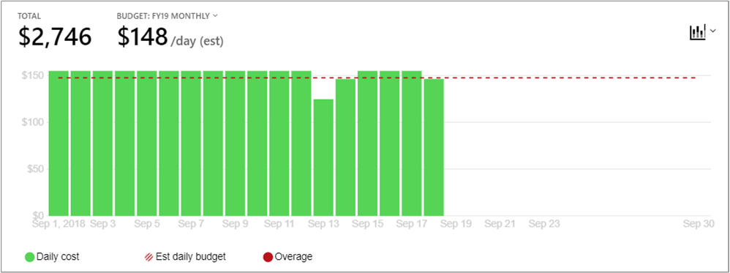
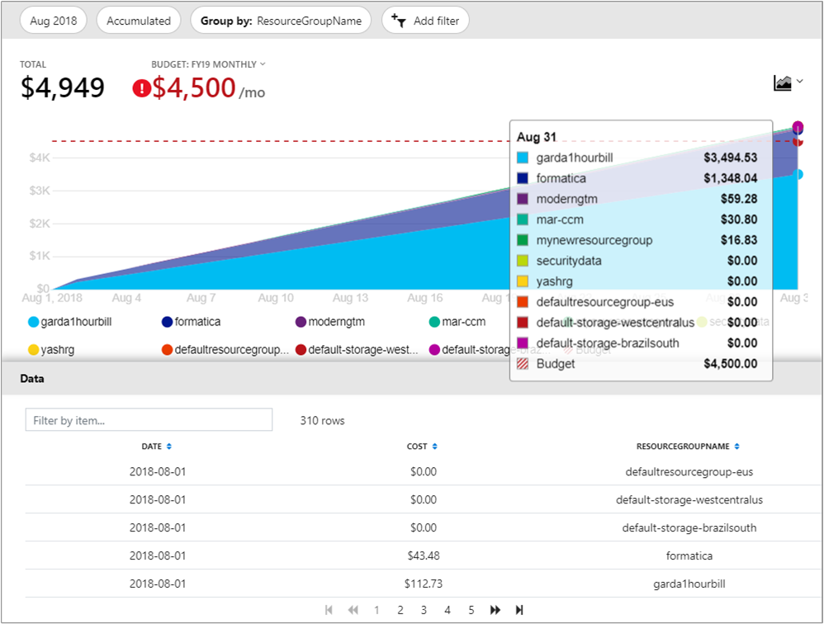
Common scenarios
Azure cost management
Understand where costs originate
Set budgets and alerts
Roll up reports across the organization with management groups
Delegated access to reports and usage

Slide 15
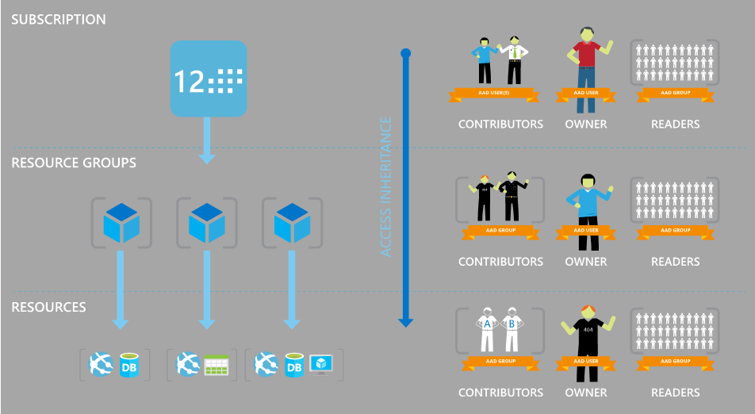

Common scenarios
Role-based access control (RBAC) and Azure policy
Governance of Azure resources
Granular access control

Slide 16
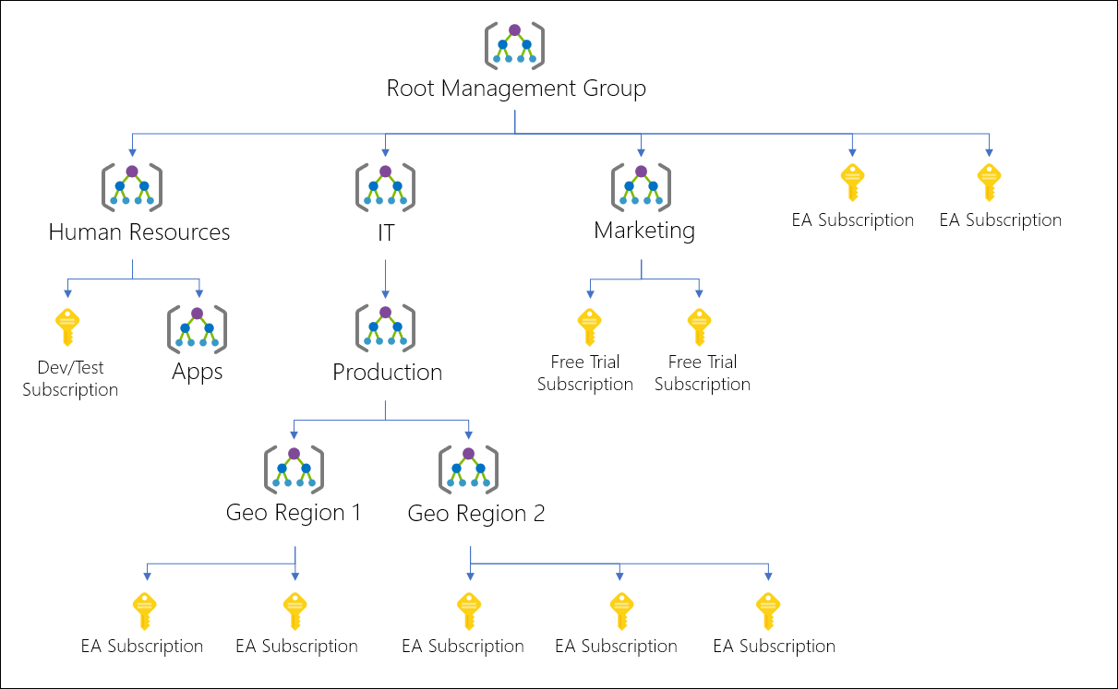
Common scenarios
Management groups
Apply governance at scale
Assign RBAC and policy across subscriptions
Aggregate Advisor, Security Center and Cost Management reports from across the organization

Slide 17


Common scenarios
Azure blueprints
Automated provisioning of entire environments
Deployment tracking and updates
Optional locking against unauthorized changes
Role-based access controls
Policy Definitions
Subscription A
Templates
Azure Blueprints
Subscription B
Subscription C
…

Slide 18
Step 2: Design the solution
Outcome
Design a solution and prepare to present the solution to the target customer audience in a 15-minute chalk-talk format.
Timeframe
60 minutes
Business needs (10 minutes) | Respond to questions outlined in your guide and list the answers on a flipchart.
Design (35 minutes) | Design a solution for as many of the stated requirements as time allows. Show the solution on a flipchart.
Prepare (15 minutes) | Identify any customer needs that are not addressed with the proposed solution. Identify the benefits of your solution. Determine how you will respond to the customer’s objections. Prepare for a 15-minute presentation to the customer.

Slide 19
Step 3: Present the solution
Outcome
Present a solution to the target customer in a 15-minute chalk-talk format.
Timeframe
30 minutes (15 minutes for each team to present and receive feedback)
Directions
Pair with another table.
One table is the Microsoft team and the other table is the customer.
The Microsoft team presents their proposed solution to the customer.
The customer asks one of the objections from the list of objections in the case study.
The Microsoft team responds to the objection.
The customer team gives feedback to the Microsoft team.

Slide 20
Wrap-up
Outcome
Identify the preferred solution for the case study.
Identify solutions designed by other teams.
Timeframe
15 minutes

Slide 21
Preferred target audience
Ken Greenwald, CTO
Laura Knight, Head of Cloud Governance team
Enterprise IT Directors
Business Unit technical leads within Enterprise IT
EA Portal Administrators

Slide 22
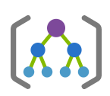

Subscription organization
Trey Research (Tenant Root Management Group)
Hierarchy reflects business units and subunits
Enables roll-up cost reporting and one-time RBAC and policy configuration
Separate Production, Pre-production and Dev/Test management groups
Separate subscription per application
Industrial & Consumer
Electronics
Life Sciences
Product Development
Marketing
Sales & Support
US
Europe
Asia
Production
Pre-Prod
DevTest
App1
App2
Shared Services
Notes:
The first step in implementing Enterprise governance is to ensure all Azure subscriptions are organized into an appropriate hierarchy.
For Trey Research, the hierarchy will comprise the tenant root management group, followed by a separate management group for each business unit (Electronics, Life Sciences, etc). Under each of these management groups sits another management group for each subunit (Product Development, Marketing, Sales & Support). An additional management group layer is used for the regional subunits within Sales and Support.
Under each of these management groups, subscriptions used by each subunit are created, and applications deployed within each subscription. This can be organized in several ways. It is a good idea to group production deployments together, at either the subscription level or by including an additional management group level. Likewise, pre-production deployments and Dev/Test deployments should also be grouped.

Slide 23
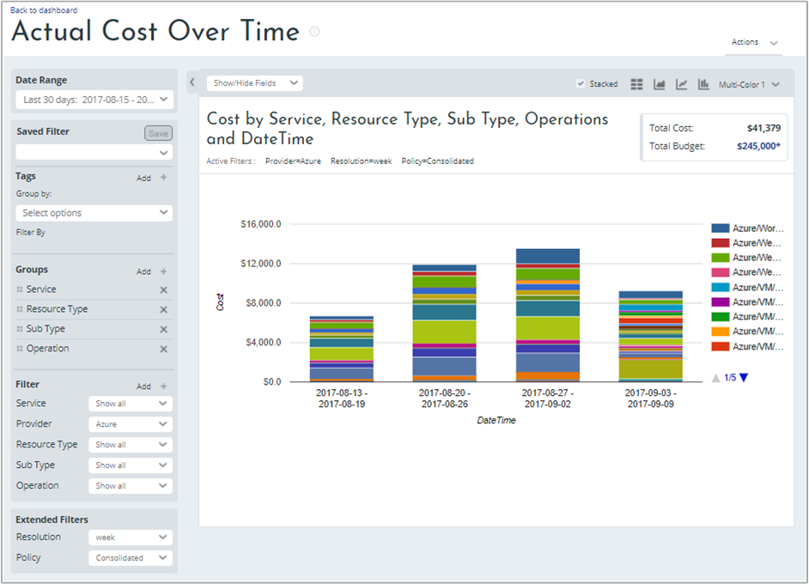
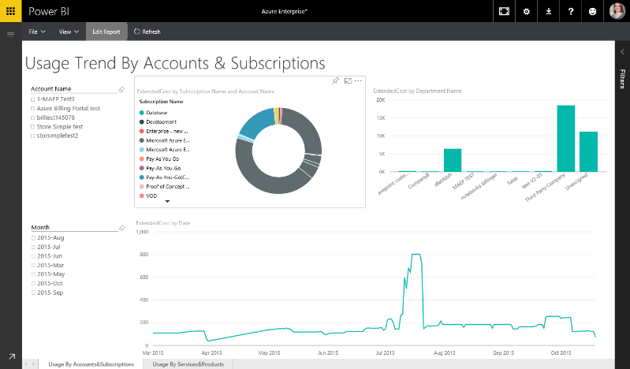
Cost management options
Azure Cost Management
Azure Portal
Based on management groups
Focus of future investment
Cloudyn
Dedicated portal
Uses own hierarchy
Closed to new registrations (except CSP partners)
Enterprise Agreement
EA Portal / Power BI
Based on EA hierarchy EA → Dept → Acct → Sub
Notes:
For cost management, costs can be aggregated in a subscription hierarchy for roll-up reporting. There are several different cost management tools, and each uses a separate hierarchy:
- Cost management in the Azure portal uses the management group hierarchy.
- Azure Cost Management by Cloudyn uses a hierarchy defined within the Cloudyn tool
- EA subscriptions are organized into a 4-level hierarchy, comprising the EA (root), departments, accounts, and subscriptions.
Where multiple cost management tools are used, it will make most sense to mirror the same hierarchy across each tool. We will focus on the management group hierarchy, since this hierarchy is also fundamental to many of the other governance controls Trey will use.

Slide 24
Azure Cost Management
Cost analysis
Filter and/or segment by resource type, location, tags, etc
Aggregated to management group, subscription or resource group scope
Define budgets and alert thresholds
CSV download for offline analysis
EA subscriptions must enable 'AO view charges' in EA portal
Notes:
Cost Analysis allows you to analyze your Azure spend. After first defining your date range, you can then view charts of either daily, monthly, or cumulative spend. These charts can be filtered or segmented based on a wide range of criteria, such as resource group, resource type, location, or based on resource tags. This variety of charts and ability to drill down into the data is useful for investigating spending anomalies.
For more information, see https://docs.microsoft.com/en-us/azure/cost-management/quick-acm-cost-analysis#review-costs-in-cost-analysis
You can define a budget, and configure alerts when a %age of that budget is spent. Alerts are integrated with action groups, enabling a variety of alert actions (such as email, SMS, or even triggering custom automation).
For more information, see https://docs.microsoft.com/azure/cost-management/tutorial-acm-create-budgets
Cost analysis, budgets and alerts can be defined at a variety of scopes, from management groups to subscriptions to individual resource groups (see the cost management features on the respective management group, subscription and resource group blades). Information from cost analysis can also be downloaded through a detailed .csv with any filters or groupings applied to the exported data.
NOTE:
Users must be assigned the Cost Management Reader role at the appropriate scope to have access to cost analysis reports. These permissions are also included in the Reader, Contributor and Owner roles.
For EA subscriptions, an Enrollment Administrator must enable "AO view charges" in the Azure EA Portal to enable cost views in Azure Cost Management.
For further details, see https://docs.microsoft.com/azure/cost-management/assign-access-acm-data.

Slide 25
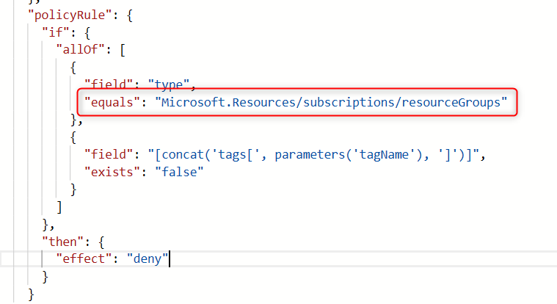
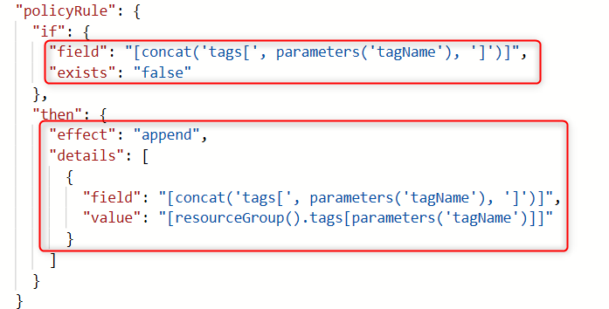
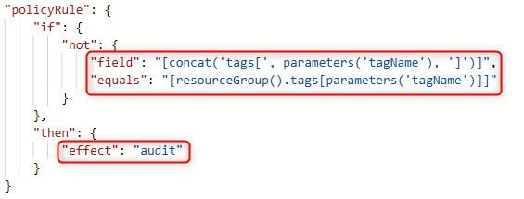
Tracking usage
Use Azure Policy to enforce tagging of resource groups and resources
Require specified tag on resource groups
Built-in policy
"mode": "all"
Append tag and its value from the resource group
Built-in policy
"mode": "indexed"
Audit resource tag matches RG tag
Custom policy
"mode": "indexed"
Notes:
**Design:**
Design a charge back mechanism for the business units for resources they consume based on the IO code for each application. Assuming your design is based on resource-level tags, how will you implement the following use cases?
- Every resource group must have an 'IOCode' tag
- Every time a resource is created, it is assigned an 'IOCode' tag with a value matching its resource group
- Any resource whose 'IOCode' tag is missing or does not match its corresponding resource group tag (for example, after moving the resource between resource groups) can be easily identified. Child resources, for which tags to not apply, are excluded.
**Solution:**
The IOCode tag will be implemented using three separate Azure policy definitions.
The first policy requires that all resource groups are assigned the 'IOCode' tag. The built-in policy **Require specified tag on resource groups** can be used. Note that this policy uses '"mode": "all"', since the alternative '"mode": "indexed"' does not apply to resource groups. The policy rule is specific to resource groups only.
Note: This policy will require that all resource groups specify the IOCode tag *at the time they are created*. Using the Azure portal, it will no longer be possible to create a resource group at the same time as deploying a resource. You will need to create the resource group separately so the resource group tag can be specified.
The second policy requires that each resource is assigned an 'IOCode' tag upon creation. If the 'IOCode' tag is missing, then it is added automatically, using the value from the corresponding resource group tag. The built-in policy **Append tag and its value from the resource group** can be used. Note that this policy uses '"mode": "indexed"', which ensures this policy only applies to resources which can be tagged, and not to child resources which do not support tags (such as subnets of a virtual network).
The above policy does not enforce that the IOCode tag, if present when the resource is created, matches the IOCode tag of the resource group. This case will be audited by our third policy. However, this policy could be used a basis for a custom policy which does enforce that the IOCodes on the resource and resource group match.
The third policy audits that the IOCode tag is present on all resources, and that its value matches the value of the corresponding resource group tag. As with the previous rule, '"mode": "indexed"' is used to avoid creating false audit reports for child resource types. In this case, a custom definition is required.
These three policy definitions are grouped into a single policy initiative, for ease of management. A single initiative parameter, 'Tag Name', is passed to all three policy definitions.
This initiative will then be assigned at an appropriate management group scope (perhaps even the tenant root management group) so the policies are effective across all subscriptions in the organization.

Slide 26
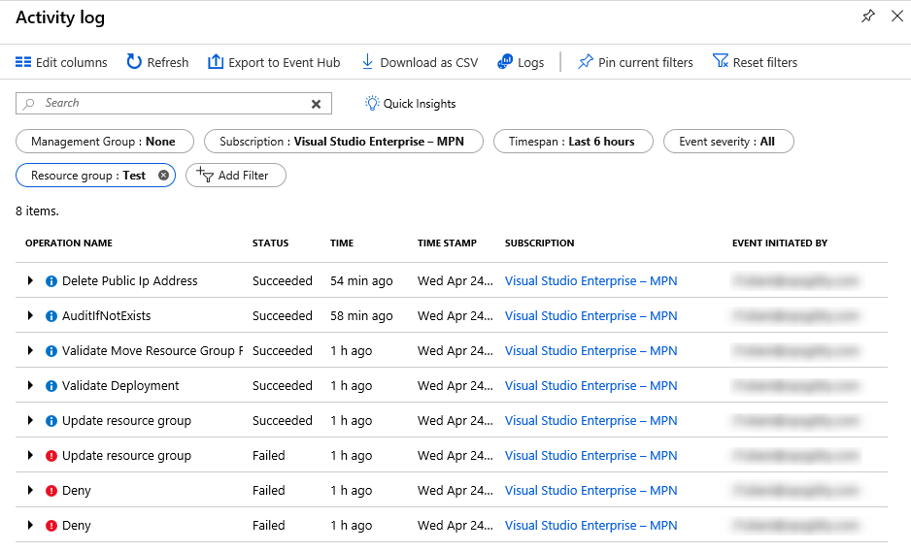
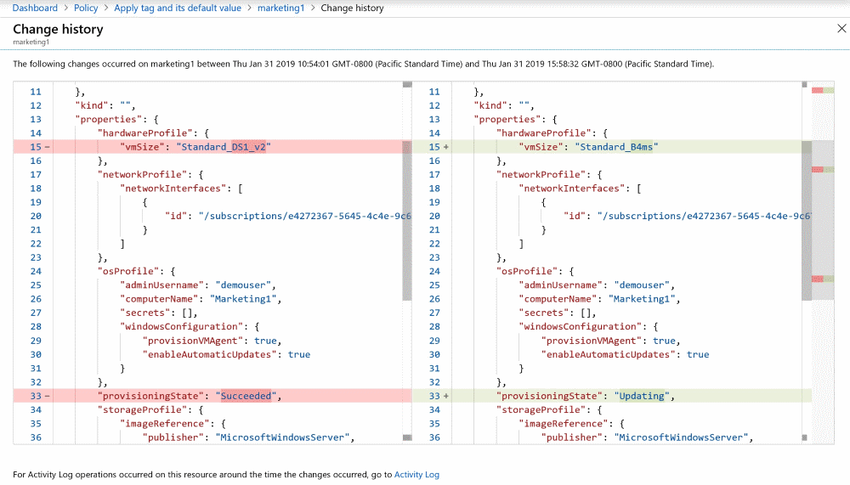
Investigating outages
Resource changes: Activity Log and resource graph change history
In-VM changes: Azure automation change tracking solution
Who, when, which resource, what operation
Resource properties before/after 14 days only, in preview
Notes:
**Design:** Following an outage, how can you identify and analyze any recent changes which may have contributed? Investigations will require details of which resource was changed, when it was changed, who made the change, and what was changed. How can you track changes to both resource properties (capturing both before and after state) as well as changes inside a virtual machine?
**Solution:** The Azure activity log provides a full history of changes to the configuration of Azure resources. It shows when changes were made, and which account made the changes. The log can be filtered in many ways (resource type, resource group, time, event severity, etc) and also exported as a CSV for processing off-line.
However, the activity log does not provide details of exactly which resource properties were changed, nor the before/after values of those properties. This data is available from the change history feature of the Azure resource graph (currently in public preview).
To view the change history for a resource in the Azure portal, identify and click on the resource in any Azure policy compliance report (the compliance status of the resource doesn't matter). Then click the **Change History (preview)** tab.
This tab shows a list of timestamps for each change. Click on a timestamp to see a visual diff of the change.
For more information on the resource graph change history, see https://docs.microsoft.com/azure/governance/resource-graph/how-to/get-resource-changes and https://docs.microsoft.com/azure/governance/policy/how-to/determine-non-compliance#change-history-preview.
The change history only captures changes to resource properties. It does not capture changes that occur within an Azure VM. To monitor VM changes, the Azure Automation Change Tracking solution should be used. Supporting both Windows and Linux, this solution tracks VM changes including files, registry keys, services/daemons, and software deployments. For more information, see https://docs.microsoft.com/azure/automation/automation-change-tracking.

Slide 27
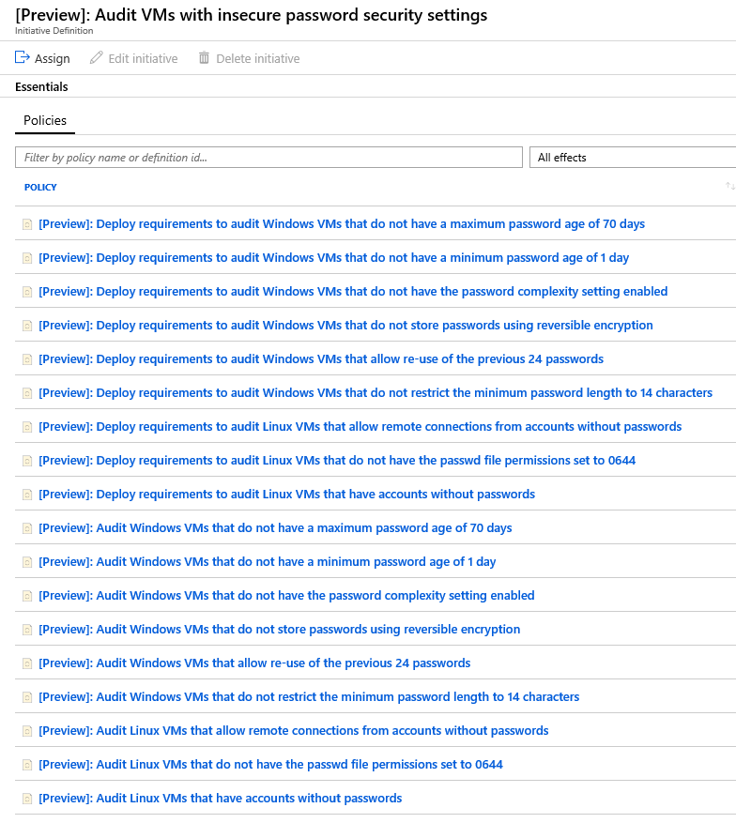
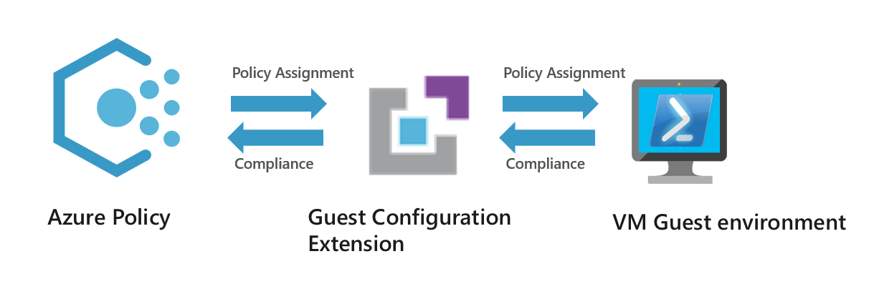
Password complexity
Use VM guest policy to audit password settings
Built-in policies, rolled up into a policy initiative
Windows and Linux
Preview
Notes:
**Design:** How can you ensure that both Windows and Linux VMs meet password complexity requirements?
**Solution:** Azure policy guest configuration allows Azure policy to be used to audit settings with an Azure VM (Windows and Linux). It can be used to audit and deploy application settings and installed software. It can also be used to enforce password age and complexity rules. A variety of built-in policy definitions are available. The built-in policy initiative **[Preview]: Audit VMs with insecure password security settings** contains a default collection of password policy definitions for both Windows and Linux VMs.

Slide 28
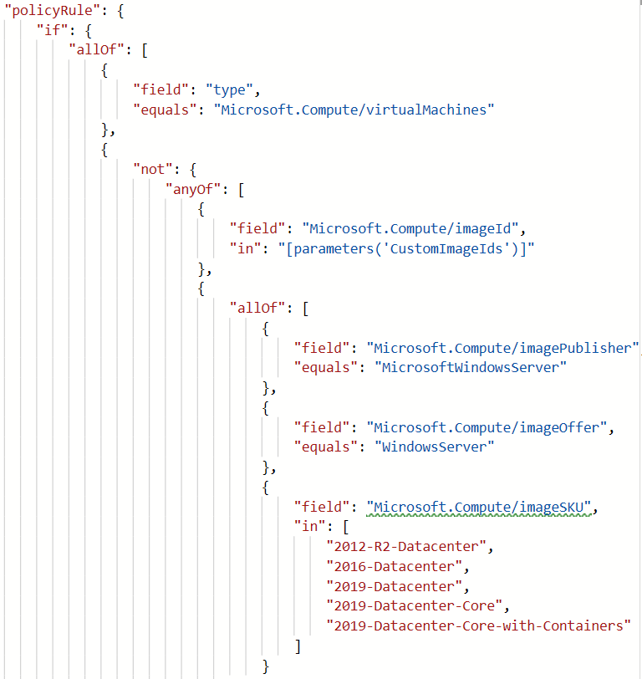
Control VM images
Use Azure Policy to control which VM images are allowed
Example shows custom images (parameter) and built-in images
Notes:
**Design:** How can you ensure that only approved OS images are used when creating new VMs? Your implementation should support a customizable list of built-in images as well as custom images.
**Solution:** Azure policy can be used to control which OS images may be used with any Azure VM. Both built-in and custom images can be supported. The built-in policy **[Preview]: Audit Log Analytics Agent Deployment - VM Image (OS) unlisted** provides an example that can be used as a baseline for a custom policy.

Slide 29
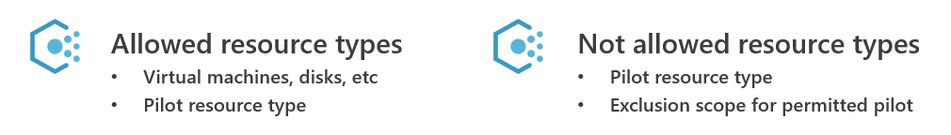
Restricting services
Use Azure Policy to enforce catalog of permitted Azure services
Control both resource type and scope of any exceptions
Allowed resource types Provides global restriction on permitted resource types
Not allowed resource types Restricts certain types to certain scopes
Notes:
**Design:** Identify a solution to restrict which services can be used in each Azure subscription, across the company. How will your solution allow exceptions for specific resource types for approved pilot projects or one-off deployments?
**Solution:** The Cloud Governance team will use Azure policy to control which Azure resources can be created, and also to grant exceptions.
The first policy be the built-in policy **Allowed Resource Types**. They will choose each resource type that is permitted for use, and assign the policy at management group scope for the business units or even the entire organization.
To permit exceptions, two approaches are possible.
The first approach is to define an exception scope for the above 'Allowed Resource Types' policy assignment. The exception scope will typically be a subscription or resource group, but also could be an individual resource. This works well when the exception is a specific resource, for example to allow creation of an ExpressRoute circuit for shared use across the organization, since the exception path includes the resource type. However, where the exception scope is a subscription or resource group, this approach allows resources of **any** type to be created in that scope, which doesn't meet the requirement for controlled exceptions.
Instead, an alternative approach is to modify the list of resource types in the 'Allowed Resource Types' policy assignment to add the new resource type. The requirement to limit the types of resources is maintained, but in this state the resource can deployed everywhere, which is often not desirable for one-off deployments. To restrict the scope at which these one-off resources can be deployed, a second built-in policy **Not Allowed Resource Types** is assigned, again at the management group scope, blocking just this new resource type everywhere except on an exception scope defined in this second policy assignment.
This alternative approach has the advantage of allowing exceptions that are limited both in the scope at which the exception is granted, and in the type of resource permitted.
Restricting resources on resource type may not suffice. For example, all VMs share the same resource type, but they differ vastly in costs depending on the VM family and size. Likewise, managed disks are all one resource type, but vary hugely in cost based on the storage type and disk size. Additional policies may be required to obtain adequate control over these resource types.

Slide 30
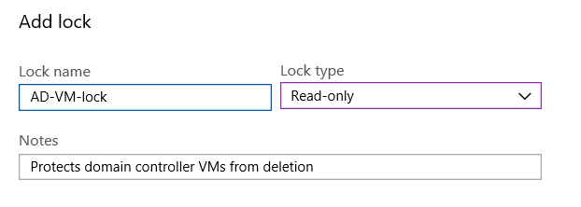
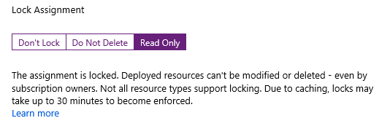
Prevent accidental resource deletion
Resource locks
ReadOnly or DoNotDelete
Controlled by subscription Owner or User Access Administrator (not Contributor)
Blueprint locks
ReadOnly or DoNotDelete
Can only modify resources by deploying a blueprint update
No workarounds, even for subscription Owner
Notes:
**Design:** How can you prevent accidental deletion of production resources, by administrators who require access to manage those resources?
**Solution:** There are two ways to prevent accidental resource deletion: resource locks, and blueprints.
Azure resource locks are used to 'lock' a resource against accidental changes. There are two types of lock: 'Read Only' locks prevent all changes. 'Do Not Delete' locks allow a resource to be modified, but not deleted.
Azure resource locks can be assigned at the subscription, resource group, or resource level (they cannot be assigned at management group scope). They apply to all resources within that scope. For example, a 'Do not delete' lock on a resource group prevents any resource in that resource group from being deleted, but does not impact resources in other resource groups.
Any attempt to delete or modify a resource that is subject to a 'Read Only' lock will fail, as will attempts to delete a resource subject to a 'Do Not Delete' lock. The lock must first be removed, then re-created if necessary once the change has been made.
Creating and deleting resource locks requires dedicated RBAC permissions. These are included in the 'Owner' role, but not the 'Contributor' role. They can be assigned using the 'User Access Administrator' role.
Another way to prevent accidental resource modification or deletion is to deploy the resources using an Azure blueprint. Each blueprint assignment can optionally lock the blueprint resources. Again, two lock types are supported, 'Do Not Delete' and 'Read Only'. In this case, the **only** way to change or delete the resources is by deploying an updated version of the blueprint. Even the subscription owner cannot override blueprint locks.

Slide 31
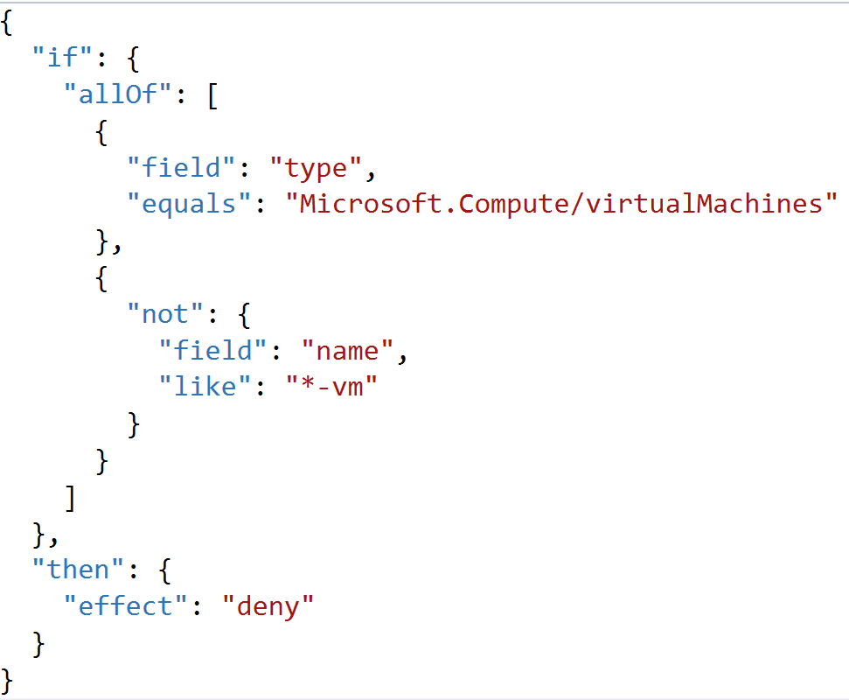
Enforcing naming convention
Create policies using the name field by resource type
Assign via a policy initiative
Grouping policies, one for each resource type
Notes:
The above example shows how to enforce a simple naming constraint on a single resource type—virtual machines. Enterprise IT need to enforce their convention across all their resource types. Implementing this in a single policy requires an impractically-large conditional logic in the policy rule.
Instead, separate policies should be created for each resource type. These policies should then be combined into a single policy initiative. Using a policy initiative allows the entire set of policies to be assigned in a single operation. It also allows new naming rules to be added easily—simply add the new rule to the initiative and it will be applied across all existing assignments.

Slide 32
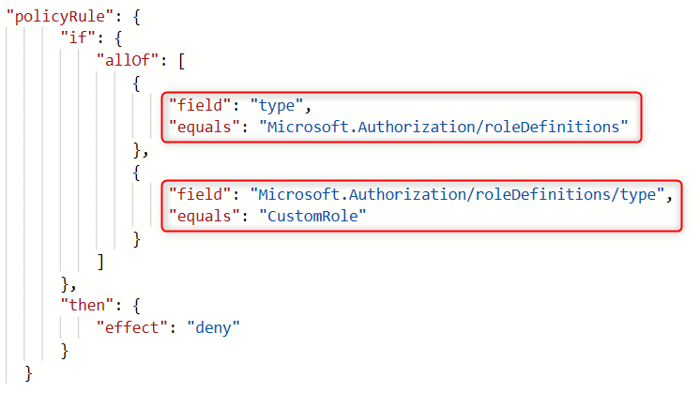
Identity and access control
Create Azure AD group for each business unit
Add business unit admins to group
Add the Azure AD group to contributor role
Use RBAC to assign permissions with management groups for cross subscription management
Azure built-in roles allow fine-grained permissions. Block custom roles using Azure policy
Azure AD B2B collaboration allows access for external contingent staff
Contingent staff can use VPN access to Azure deployments if necessary
Notes:
**Design:** How can you delegate access management to business units for each application they own, while protecting other applications and ensuring that controls implemented by the Cloud Governance teams cannot be circumvented?
**Solution:** This can be achieved using Azure role-based access control (RBAC). Create a group in Azure AD for that business unit, for example, BU1-Azure-Managers, and add those users to the group. Add the Azure AD group to the contributor role and assign that role to the subscription used by the business unit. A similar approach can be used for sub-units or teams within the business unit, assigning the contributor role to either dedicated subscriptions or individual resource groups.
Contributors do not have permissions to add or remove users or change policies. They are also unable to move a subscription between management groups. Hence, they cannot override controls defined by the Cloud Governance team.
**Design:** How can you ensure staff have access to what they need, but no more, while enforcing that only built-in roles are used.
**Solution:** As with the previous question, role-based access control can be used to ensure staff have access to what they need, but no more. Rather than using the general-purpose contributor role, Azure also provides fine-grained roles that grant permission to use specific Azure services. For example, a network engineer may be granted the Network Contributor role, so they can manage network resources only. They might also be granted the Reader role, so they can view, but not modify, the resources using the network.
To restrict use of RBAC to built-in roles, Azure policy can be used. The following example shows a policy rule which prevents the use of custom roles.
**Design:** Identify a solution to streamline identity management and provide remote access for e-commerce team contingent staff.
**Solution:** Using Azure AD, contingent staff can be granted access to Azure resources using their existing Azure AD identity, rather than having to create a new identity in the Trey directory. This simplifies identity management.
Azure resources are managed via Azure resource manager, which means that can be managed from any Internet-enabled location. Access to the Trey premises or network is not require for resource management.
Using templates and 'infrastructure as code', it is easy to deploy new Dev and Test environments for contingent staff.
If network access to an existing Trey deployment is required, this can be implemented using a VPN. This can be either a site-to-site VPN from the contingent staff offices to the Trey virtual network, or individual point-to-site VPNs for each contingent staff team member. Access can be limited as necessary using network security groups.

Slide 33
Deployment acceleration
Use resource manager templates for 'infrastructure as code'
Use template parameters to tailor deployments for each environment
Use blueprints to track deployments and controlled roll-out of updates
Blueprints can also protect reference implementations from tampering
Role-based access controls
Policy Definitions
Subscription A
Templates
Azure Blueprints
Subscription B
Subscription C
…
Notes:
**Design:** How can Trey implement an 'Infrastructure as Code' approach to deployment automation, while still allowing different footprints in different environments?
**Solution:** Resource manager templates provide a declarative means to deploy Azure resources. Each template file describes all the resources to be deployed, and Azure takes care of the deployment process. This provides a fully-automated way to deploy entire applications, including all networking, storage, compute and other components.
Template files can be stored and managed similarly to source code, using a repository. This provides a central archive with version control.
Each template file can be parameterized. These parameters can be used to control details which vary between each deployment, including the deployment footprint (size and number of VMs, etc). Parameters are specified using parameter files, which are specified together with the template itself at deployment time. These parameter files can also be stored in source control. This allows the same template to be used for different environments, by using a different parameter file to tailor each deployment.
**Design:** How can the Cloud Governance team track where their best-practices reference implementations are deployed, and manage updates to those deployments?
**Solution:** The Cloud Governance team can use Azure blueprints to publish and managed their best-practice reference implementations of common deployments.
Azure blueprints build on top of Azure templates. Each blueprint specifies a collection of artifacts to deploy---these can include templates, policy, and role-based access control permissions.
Unlike templates, blueprints are stored and managed inside Azure. They are fully versioned, and each deployment is tracked. This allows you to easily identify all deployments of a particular blueprint. The blueprint version for each deployment is also tracked, enabling controlled roll-out of updated versions across deployments.
**Design:** How can the Cloud Governance team prevent best-practice reference implementation deployments from being modified outside of their control?
**Solution:** Azure blueprints support locking of deployed resources. There are two types of lock: 'Read Only' and 'Do Not Delete'. These locks prevent the deployed resources from being modified except by deploying an updated version of the blueprint.
There are no workarounds or backdoors---even the owner of the subscription in which the blueprint has been deployed cannot override the locks imposed by the blueprint.

Slide 34



Minimize wasted spend on non-prod VMs
Azure DevTest Labs
Configure automatic start/stop time
Start/Stop VMs during off-hours solution starts and stops
Azure Advisor low-utilization recommendations
Azure Cost Management (by Cloudyn)
Notes:
For Dev/Test scenarios, Azure Dev/Test Labs enables the full lifecycle of Dev/Test environments to be managed, including hours of use, and policies on the number and size of VMs per user and per lab.
Each VM can be configured with a time at which it will automatically shut down until restarted. This is available in the management portal when creating the VM, or afterwards. This feature was originally part of Dev/Test Labs and is now available for all VMs.
The ‘Start/Stop VMs during off-hours’ offering in the Azure Marketplace also offers the ability to automatically configure when VMs will run. This solution has the advantage that a single configuration can be applied across a subscription (selectively if necessary), rather than being applied to each individual VMs. It also has the ability to schedule VM start time as well as stop time. It could potentially be extended to auto-shutdown VMs based on their Environment tag.
Azure Cost Management (by Cloudyn) offers reports showing VM utilization and recommendations for stopping idle VMs and right-sizing under-utilized VMs.

Slide 35
Preferred objections handling
Objection
Per-subscription configuration won't scale to an organization the size of Trey Research. How can governance controls be implemented with minimum per-subscription configuration overhead?
Potential answer
Azure subscriptions should be grouped into a management group hierarchy. The root of this hierarchy is the tenant root management group. Under this root, a tree of management groups can be implemented to represent the business units and subunits within the organization. Each Azure subscription is then assigned to a management group node within this tree.
Many Azure governance controls be assigned at the management group scope, which means they apply across all subscriptions under that management group node. This enables a single configuration to apply consistently and reliably across a large number of subscriptions. Supported controls include Azure policy and Azure role-based access control. In addition, Azure Advisor, Security Center, and Activity Logs all support management group views.
Notes:
**Objection:** Per-subscription configuration won't scale to an organization the size of Trey Research. How can governance controls be implemented with minimum per-subscription configuration overhead?
**Answer:** Azure subscriptions should be grouped into a management group hierarchy. The root of this hierarchy is the tenant root management group. Under this root, a tree of management groups can be implemented to represent the business units and subunits within the organization. Each Azure subscription is then assigned to a management group node within this tree.
Many Azure governance controls be assigned at the management group scope, which means they apply across all subscriptions under that management group node. This enables a single configuration to apply consistently and reliably across a large number of subscriptions. Supported controls include Azure policy and Azure role-based access control. In addition, Azure Advisor, Security Center, and Activity Logs all support management group views.

Slide 36
Preferred objections handling
Objection
As well as implementing our governance rules on how Azure is used, we need a way to audit that no deployments have been made that bypass those rules. This audit needs to scale across the entire organization.
Potential answer
Implement governance rules using Azure Policy, and assign those Policies at the root tenant management group scope. This ensures the policy is applied across all subscriptions within the organization.
As well as controlling resource deployments, Azure policy provides compliance reports to identify any out-of-policy resource. Deploying the policy at the tenant root management group scope provides a single reports for all resources in the organization. If more fine-grained reporting is required, this can be achieved by deploying the policy at the appropriate scope.
Notes:
**Objection:** As well as implementing our governance rules on how Azure is used, we need a way to audit that no deployments have been made that bypass those rules. This audit needs to scale across the entire organization.
**Answer:** Implement governance rules using Azure Policy, and assign those Policies at the root tenant management group scope. This ensures the policy is applied across all subscriptions within the organization.
As well as controlling resource deployments, Azure policy provides compliance reports to identify any out-of-policy resource. Deploying the policy at the tenant root management group scope provides a single reports for all resources in the organization. If more fine-grained reporting is required, this can be achieved by deploying the policy at the appropriate scope.

Slide 37
Preferred objections handling
Objection
How can we ensure our deployments meet Azure security best practices, and how can we protect our Production workloads even in the event that the security perimeter is compromised?
Potential answer
Azure Security Center allows you to define your VM security policy, monitor compliance, and receive actionable recommendations on how to implement Azure security best practices. Adaptive Application Controls, available in the Azure Security Center Standard pricing tier, enable you to control whitelists of which executables can run in your Production environments.
Notes:
**Objection:** How can we ensure our deployments meet Azure security best practices, and how can we protect our Production workloads even if the security perimeter is compromised?
**Answer:** Azure Security Center allows you to define your VM security policy, monitor compliance, and receive actionable recommendations on how to implement Azure security best practices. Adaptive Application Controls, available in the Azure Security Center Standard pricing tier, enable you to control whitelists of which executables can run in your Production environments.

Slide 38
Preferred objections handling
Objection
How can Azure help control the costs associated with non-Production VMs left running out-of-hours?
Potential answer
DevTest labs, auto-VM shutdown, and the start-stop VM marketplace solution, all offer the ability to automatically shut down VMs.
Azure Advisor and Azure Cost Management (by Cloudyn) provides additional reports to identify idle VMs and to right-size underutilized VMs.
Notes:
**Objection:** How can Azure help control the costs associated with non-Production VMs left running out-of-hours?
**Answer:** DevTest labs, auto-VM shutdown, and the start-stop VM marketplace solution, all offer the ability to automatically shut down VMs. Azure Cost Management (by Cloudyn) provides additional reports to identify idle VMs and to right-size underutilized VMs.

Slide 39
Customer quote
“The governance controls Azure provides allows Trey Research to move forward with a modern enterprise cloud environment knowing that IT still is in control but allows flexibility for our business units to do their job without us in the way.”
—Ken Greenwald CTO

